Slide 1
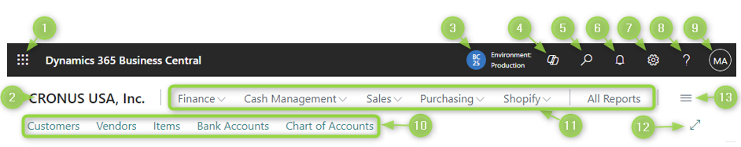

Page Parts – Home Page
Microsoft 365 apps
Company name
Company selector
Chat with Copilot
Tell me (aka Main Search, Alt-Q)
Notifications
Settings (Alt-T)
Help (Ctrl-F1)
My Account
Bookmarks bar
Action bar
Toggle Wide mode (Ctrl-F12)
Role explorer

Slide 2
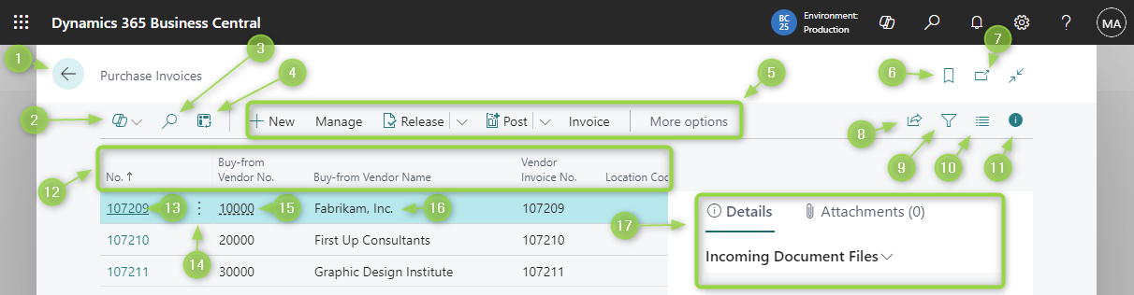
Page Parts – List Page
Go back (Esc)
Ask Copilot to analyse this data
Search in this list
Toggle analysis view
Action bar
Bookmark this page
Open page in fresh browser window
Share (open/edit in excel, share to teams, link)
Show advanced filter pane
List layout options (Lines, Tiles, Tall Tiles)
Toggle Fact Box pane (17)
Column headers (sort, filter)
Click to open the record
Line assist edit (line context actions)
Click to drill down to a different record type
Read only info
Fact Box Pane

Slide 3
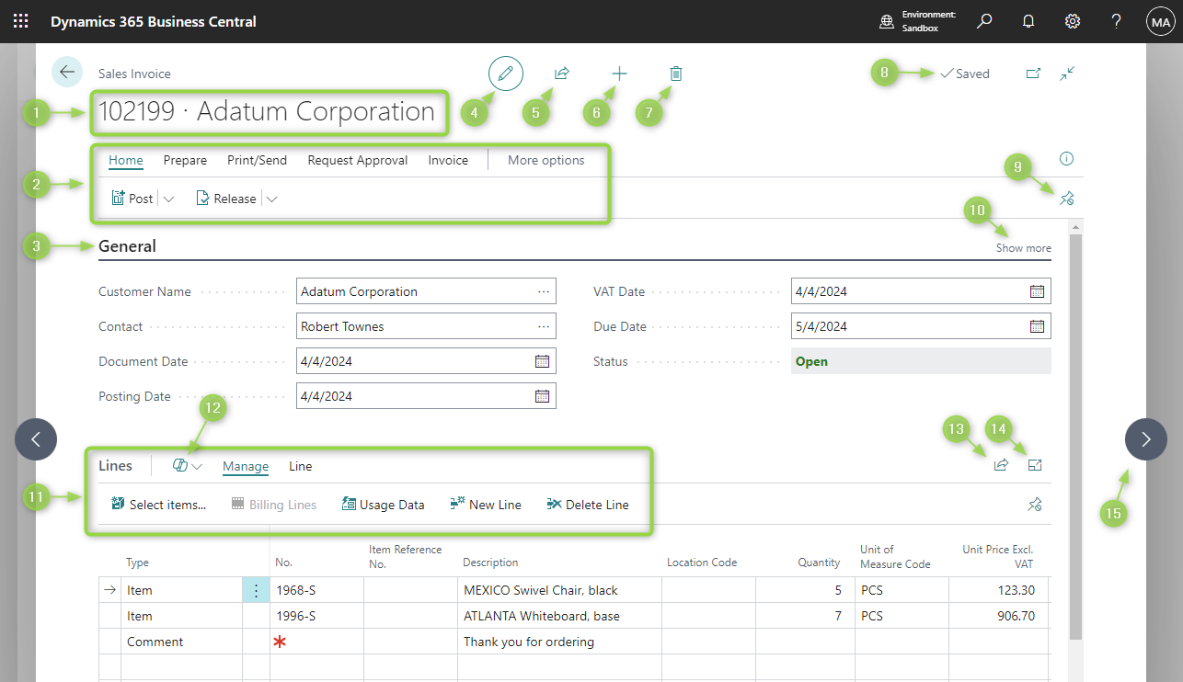
Page Parts – Record Card
Doc. No. / Info
Main actions menu
Section name (click to collapse)
Toggle edit mode
Share record (Teams / Link)
Add a new record of this type
Delete this record
Saved indicator
Pin main action menu
Show more / less in this section
Lines action menu
Ask copilot to add lines
Share lines data (Excel)
Maximise lines section
Next record

Slide 4
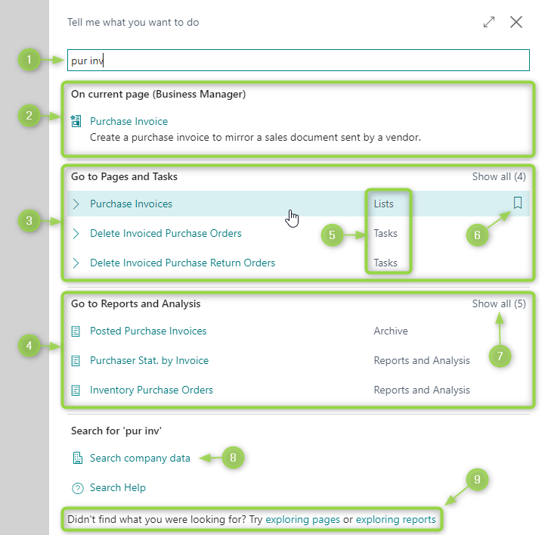
Page Parts – Tell me (aka Main Search)
Search term – intelligent searching
Actions - on current page
List pages – main search results
Reports and ledgers
Page type (List, Task, Admin etc)
Toggle Role Centre bookmark
Show more / show less
Open Full Text Search with this search term
Open page / report explorer

